Slide 1
Role of AI in Cancer Detection

Slide 2


WHAT IS CANCER?

Slide 3
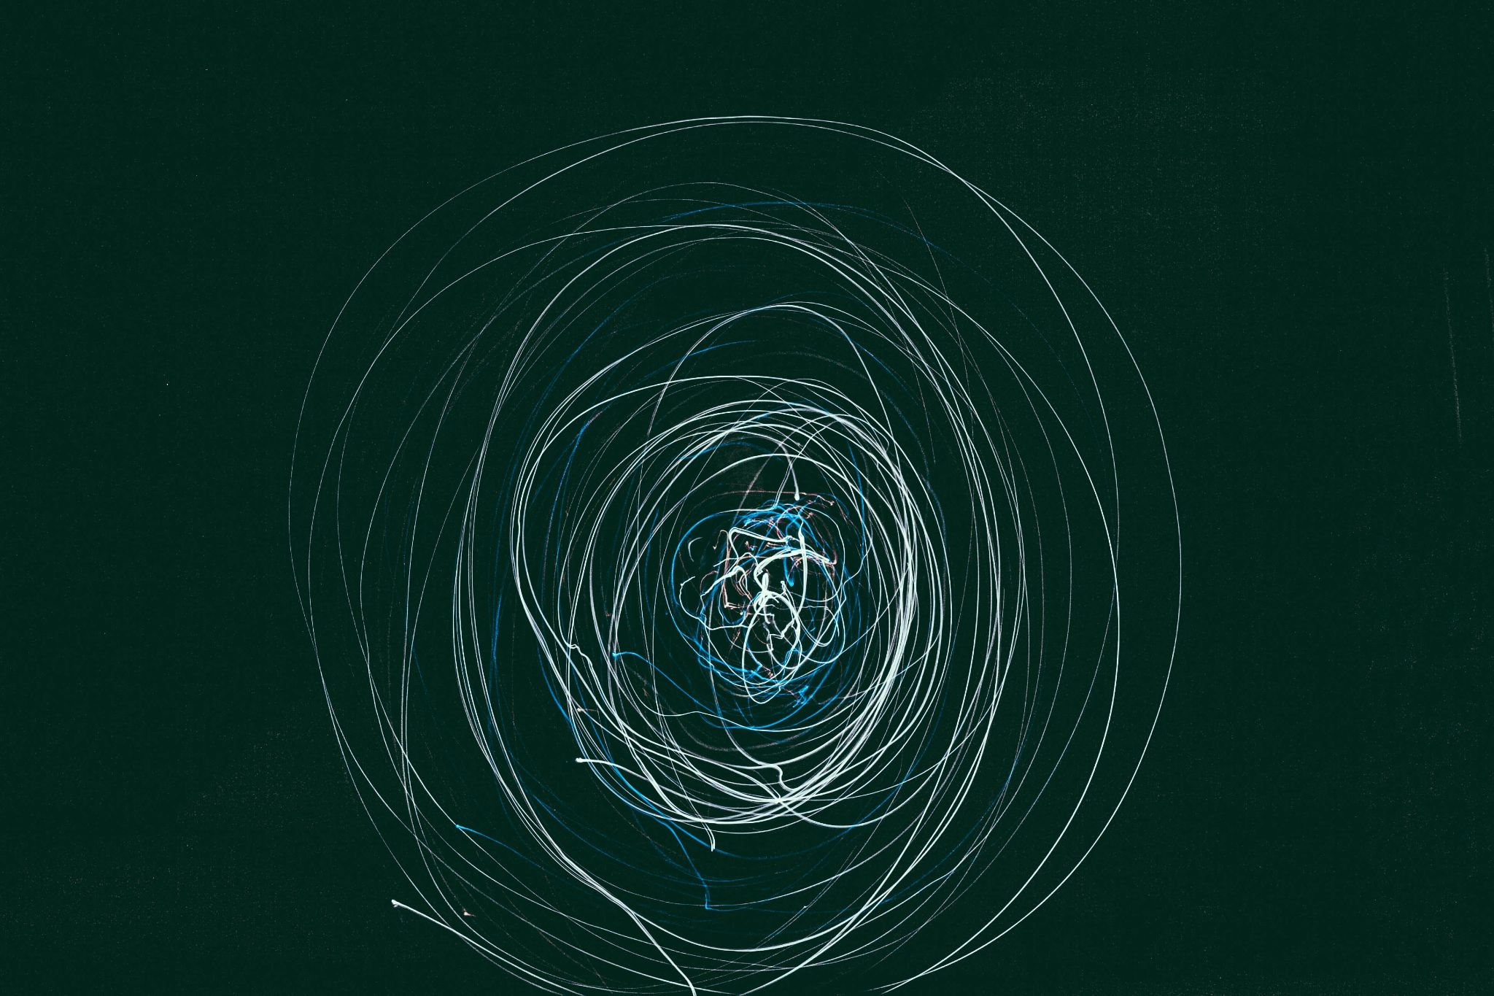
ARTIFICIAL INTELLIGENCE

Slide 4
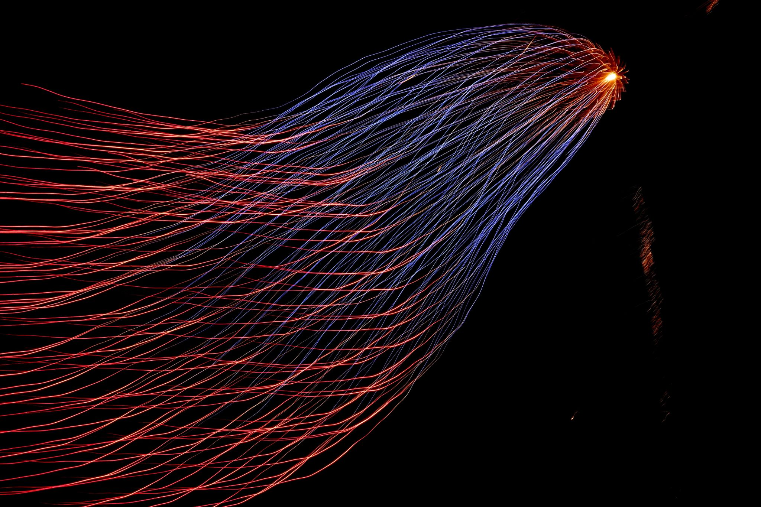
MACHINE LEARNING

Slide 5
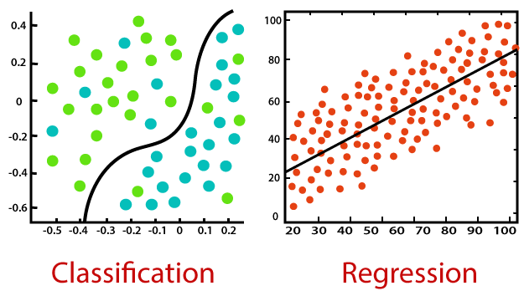
MACHINE LEARNING

Slide 6
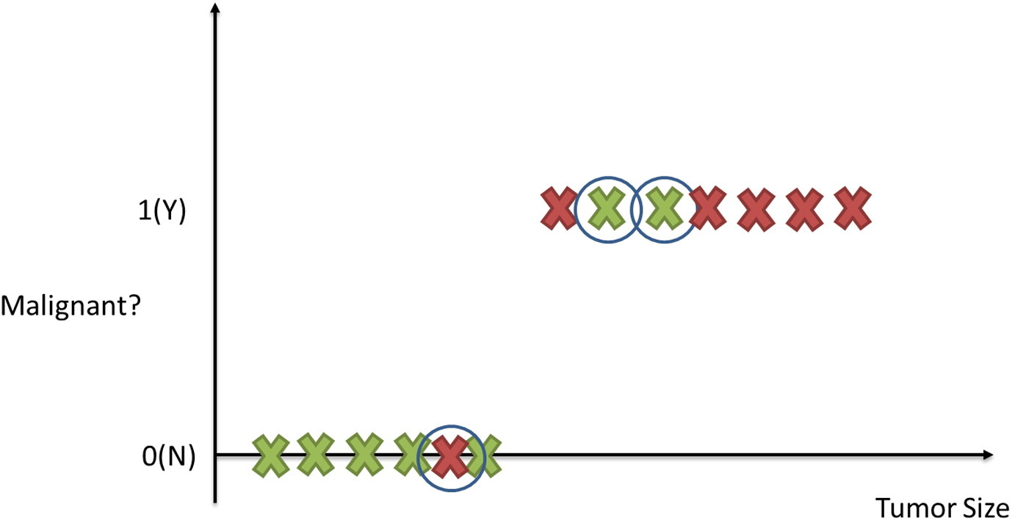
MACHINE LEARNING

Slide 7
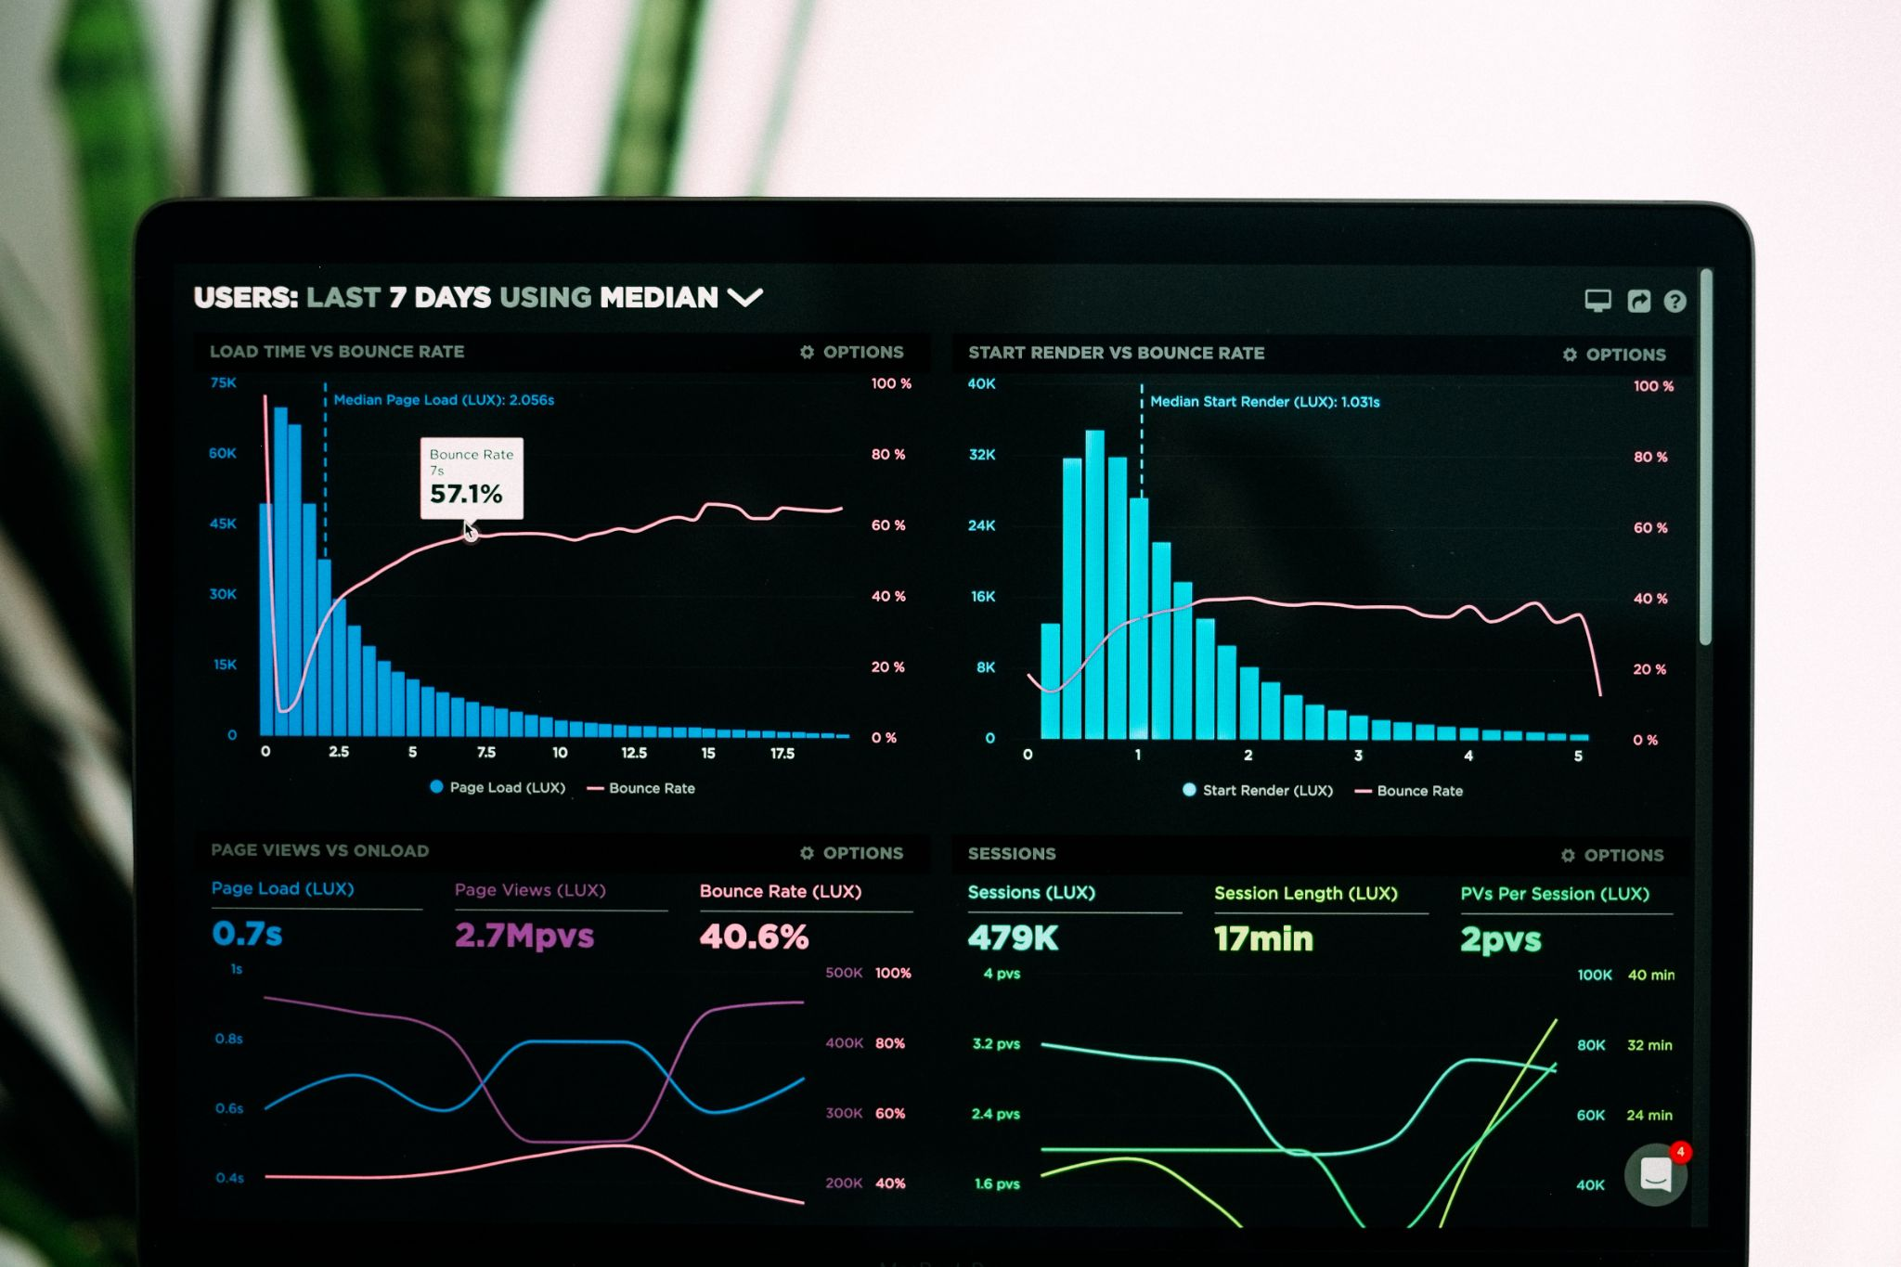
MACHINE LEARNING
ALGORITHMS

Slide 8
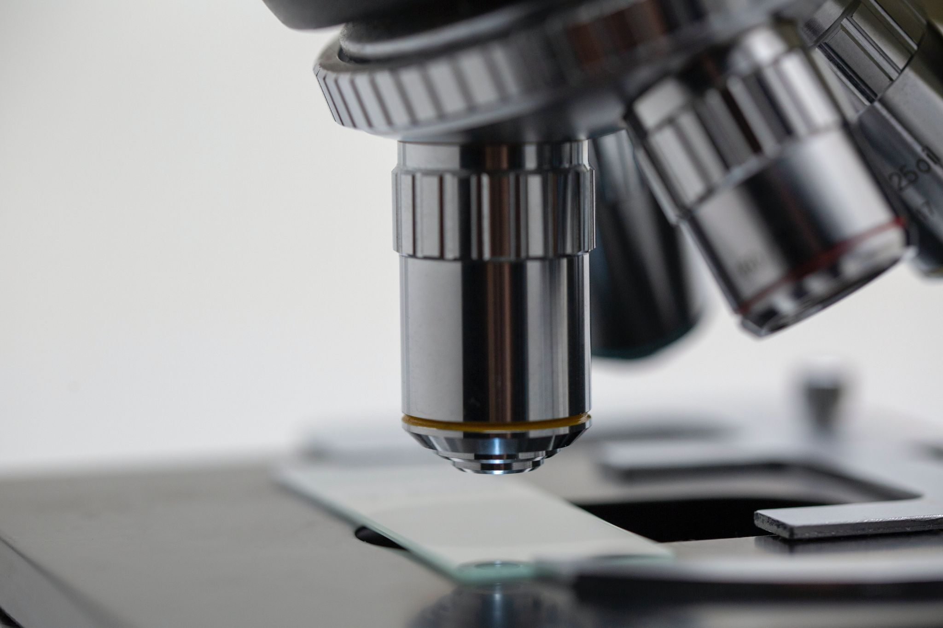
MACHINE LEARNING
ALGORITHMS
RESEARCH IS ONGOING

